Slide 1
NLP

Slide 2
Deep Learning
Recurrent Neural Networks

Slide 3
z
z
y₂
y₂
…
y₁
y₁
x₁
x₂
x₃
x₄
x₁
x₂
x₃
x₄
the
cat

Slide 4

Recurrent Neural Networks
$h_{t}=$ $σ(W_{h}h_{t−1}+W_{x}x_{t})$
h₀
w_{h}
h₁
σ
w_{x}
x₁
Notes:
Remember our notation from earlier. X is an input, h is our hidden layer, Ws are our weights, sigma is a nonlinearity – typically a sigmoid or tanh function.

Slide 5

RNN
y₁
$h_{t}=$ $σ\left(W_{h}h_{t−1}+W_{x}x_{t}\right)$
$$y_{t}=softmax(W_{y}h_{t})$$
softmax
w_{y}
h₀
w_{h}
h₁
σ
w_{x}
x₁
Notes:
As much as we love hidden layers, we probably want some actual output, so we can apply another set of weights and a softmax to h_t to give us our predicted probabilities for y_t

Slide 6
RNN
y₃
softmax
w_{y}
h₀
w_{h}
h₁
w_{h}
h₂
w_{h}
h₃
σ
σ
σ
w_{x}
w_{x}
w_{x}
x₁
x₂
x₃
The
cat
sat
Notes:
Reason to use RNNs is you have a sequence, such as a sentence.

Slide 7
Updating Parameters of an RNN
Backpropagation through time
y₃
Cost
softmax
w_{y}
h₀
w_{h}
h₁
w_{h}
h₂
w_{h}
h₃
σ
σ
σ
w_{x}
w_{x}
w_{x}
x₁
x₂
x₃
The
cat
sat
Notes:
RNNs are supervised, so once you have your predictions y, you compare them to your correct label for the sequence. For a classification problem, you use something like categorical cross entropy, and you get a cost. You then take the gradient of the cost w.r.t. the parameters to figure out how to update your parameters.

Slide 8
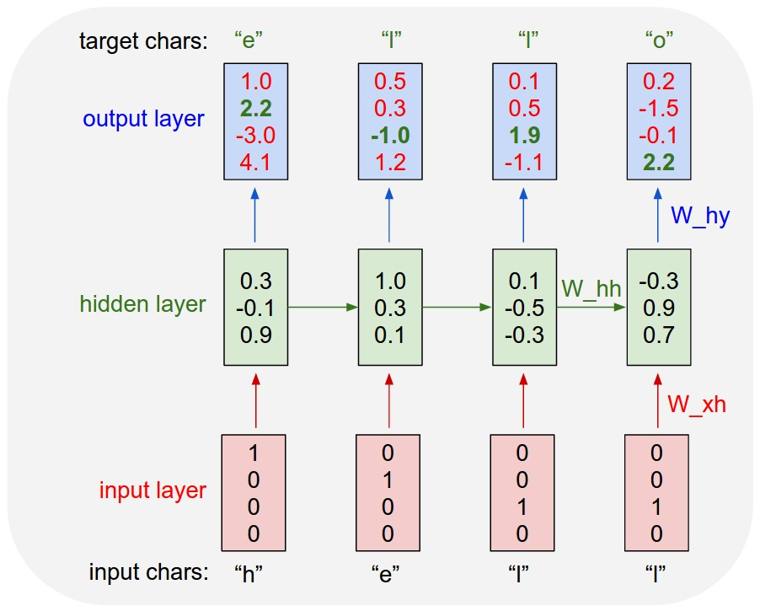
Character-based RNN
http://karpathy.github.io/2015/05/21/rnn-effectiveness/

Slide 9
Notes
RNNs are used to keep “memory”, just like finite-state automata
They can be used as generators, acceptors, transducers, etc.

Slide 10
Other Applications
Language Modeling (Mikolov 2012)
Character-level RNNs for text generation
Semantic Role Labeling:
http://www.aclweb.org/anthology/P15-1109
Dependency parsing:
http://www.aclweb.org/anthology/K/K15/K15-1015.pdf
(“producing state-of-art dependency parsing results while requiring minimal feature engineering”)

Slide 11
NLP

